Slide 1


2018 Data Professional Job Market
George Oddoye Vidhyanandhi Jegannathan
Notes:
Vidhya - Why are we all here in this bootcamp working tirelessly and tenaciously? I’m assuming we have one goal in mind, eventually to market ourselves as a competent data professional with essential skills to find the most promising companies and industries in order to compensated handsomely. Fortunately we were able to find a dataset that had relevant information regarding this goal.

Slide 2

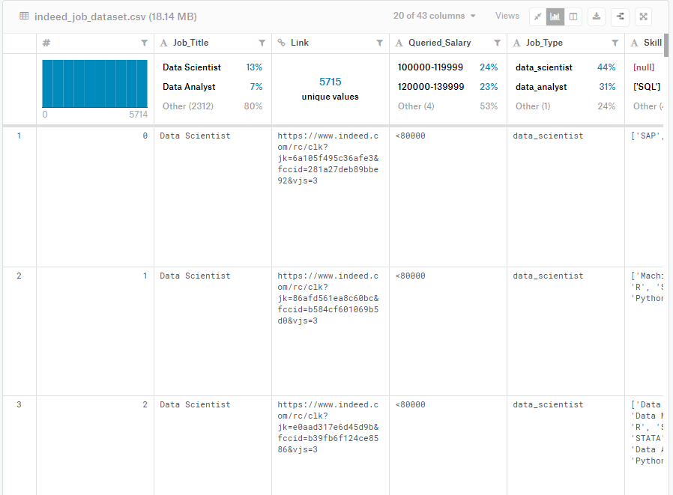
Indeed Dataset
The dataset was obtained from Kaggle.com. The data included a csv file and a description text file
  (indeed_job_datset.csv) 5715 rows x 43 columns
  (dataset description.txt)
The dataset contained the Indeed.com job posting for Data Professionals (Data Analyst/Engineer/Scientist) in 2018 across all 50 states in the United States as well as remote positions.
Purpose
  Create a Summary of Data Professional Jobs
    ( Number of Jobs/Average Salary per State)
    (Top Data Professional Industries)
    (Companies with the most job postings)
  Determine the most in demand skills for Data Professionals
    (Top Skills needed for a Data Analyst/Eng/Sci Job)
    (Top Skills needed for an Entry/Mid/Senior Level Job)
https://www.kaggle.com/elroyggj/indeed-dataset-data-scientistanalystengineer
Notes:
George- We obtained this dataset from kagggle.com (mention url). The data was created and maintained by Elroy and was last updated a year ago. The data included a csv file as well as a descriptive text file.
The dataset was 5715 rows x 43 columns contained the Indeed.com job posting for Data Professionals which include (Data Analyst/Engineer/Scientist) in 2018 across the United States as well as remote positions.
Using this data we intended to create a summary of data professional jobs which included Number of Jobs and average salary per state. We also wanted to present the top data professional industries and which companies had the most job postings.
Most importantly we wanted to discover what skills were most in demand for data professionals by comparing skills vs job type as well as salary levels .

Slide 3

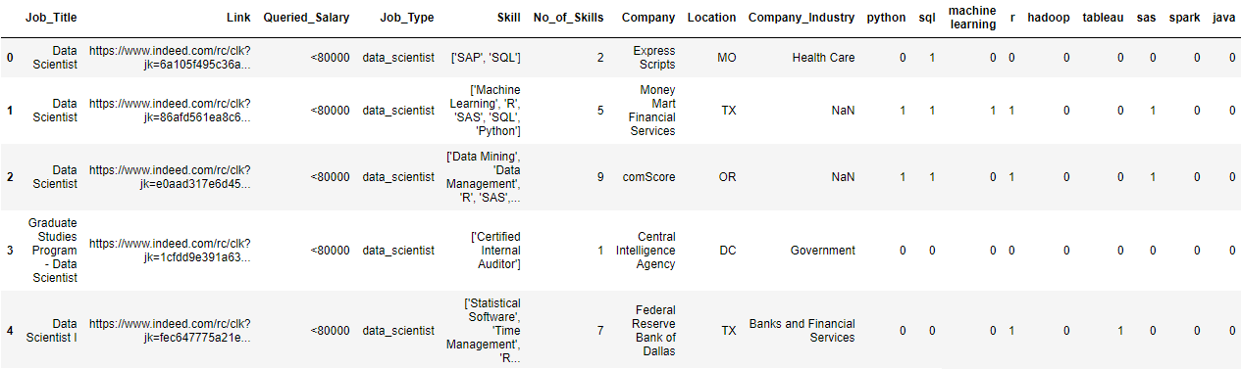
Notes:
Vidhya- As George mentioned our dataset was quite large it contained over 245,745 data entries. So we first need to find the relevant columns in our dataframe. Out of the 43 columns we selected 18 columns which were (job title,link,read all…)

Slide 4
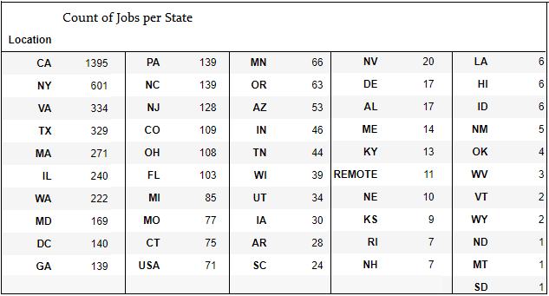
Count of Jobs per State
Notes:
George- We started the summary of our dataset by discovering the count of jobs per state. Here you can see California has the most jobs which comes as no surprise.

Slide 5
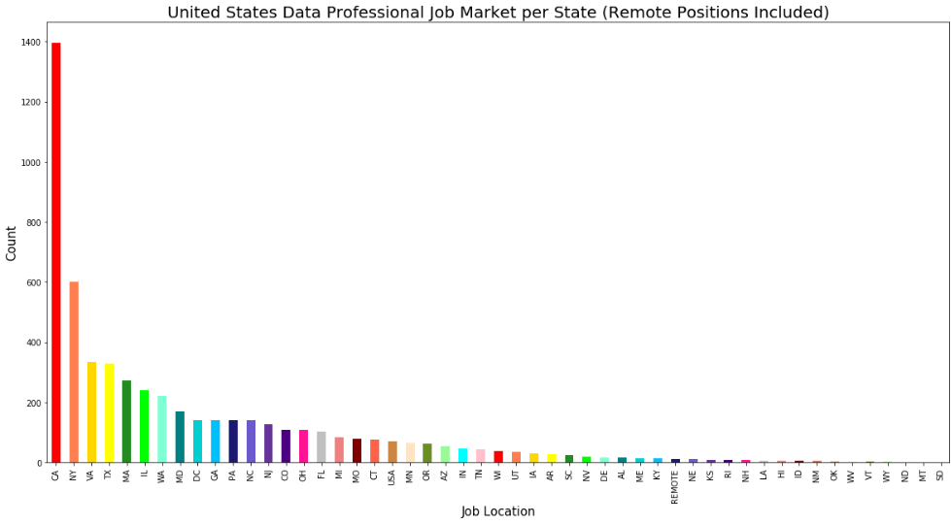
Notes:
George- We visualized the data from the summary in a bar chart. As you can see California by far has the largest job market in the united states. So much that this chart gets drowned out by the sheer volume of californias job market . Which is why we narrowed it down to the top 15 states

Slide 6
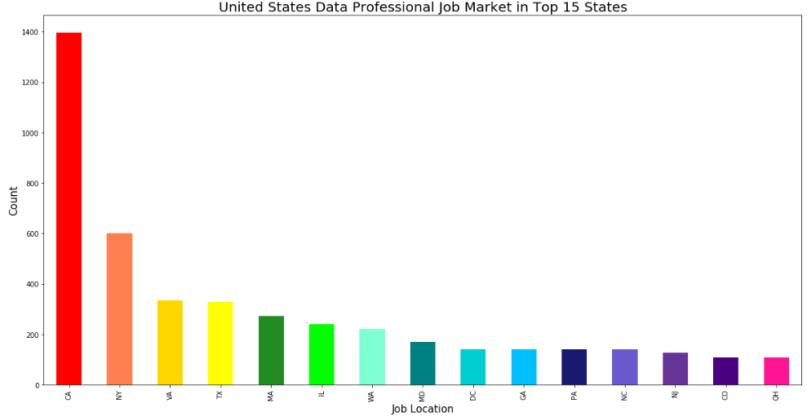
Notes:
George- This graph displays the top 15 states in a more cosumable manner. Ga happens to be the number 10 best state for data professional

Slide 7
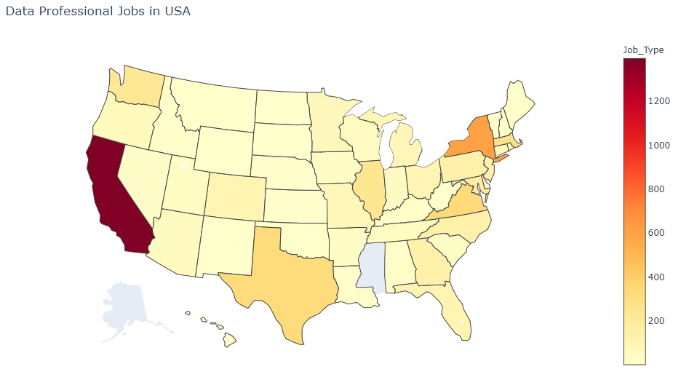
Notes:
Vidhya- Here we created a heatmap using the same data from the of the job market distribution across the united states. This heatmap does an extremely good job at highlighting the states with a high density of data professional jobs. This coincides quite well with states that are known to be highly tech and data driven for instance California, new York, seattle Washington, Texas, and illinios. I was actually unaware that there was a large presence of data jobs in viriginia

Slide 8
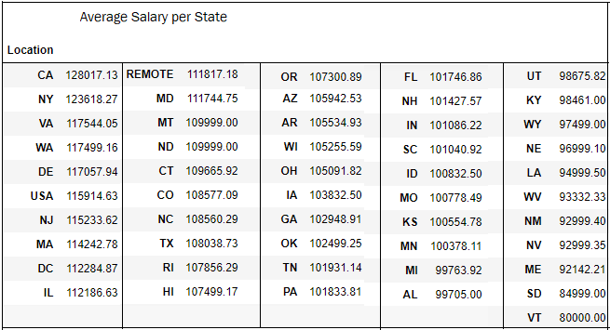
Average Salary per State
Notes:
George- next we wanted to determine the average salary a data professional earns yearly per state.
This was the first point we ran into an issue with our data. The dataset include the quiered salary for each job. However the entry included operators which prevents us from calling any math functions on the column. So we decided to create a new column and name salary based off the quieried salary. The salary column contained the same number but was stipped of all operators as well as converted salary ranges to the average.
Lastly we had to change the column type from string to interger. Now we were able to run a mean function on the column to obtained theaverage per state

Slide 9
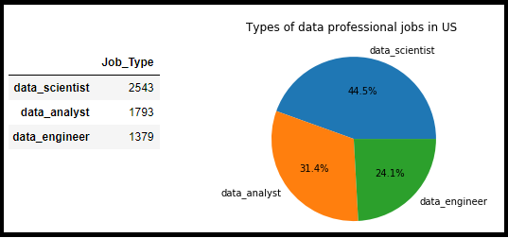
Count of Data Professional Jobs
Notes:
Vidhya- Now we wanted to identify the distribution of the job market based on the three job types. There were several job titles included in this dataset “a lot of different verbiage is used in job posting however they all were categorized into the three job typpes”
-The majority of jobs fell into the data scientist category followed by data analyst and lastly data engineer”
-one thing to take note of is the fact that there were 800-1200 more data sci jobs than the other types.

Slide 10
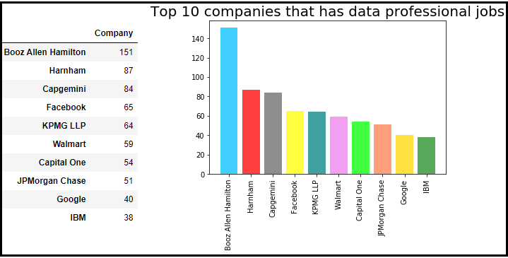
Top 10 Companies
Notes:
Vidhya- The companies offering the most jobs at the time this dataset was created were (read them)

Slide 11
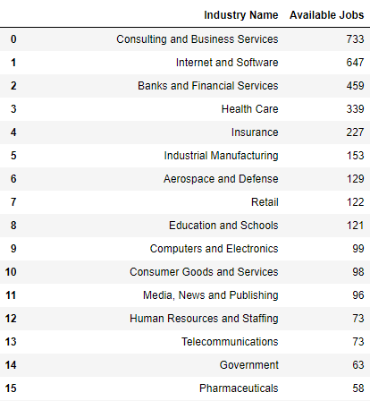
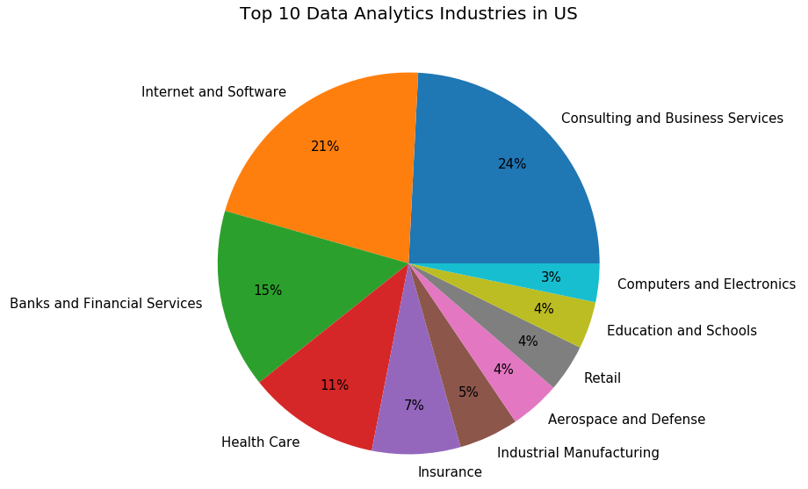
Top Data Industries
Notes:
The dataset also grouped the Jobs into specific industries. The top 4 industries for data professionals were (read them)
Vidhya-Having examined the data thus far we were able to gather pertinent information to address the first purpose of our project

Slide 12

Our project is to uncover what skills makes a person a strong candidate to become a:
  Data Scientist
  Data Engineer
  Data Analyst
As well as a strong candidate for an:
  Entry level position
  Mid level position
  Senior level position
We will examine relationships between in demand skills vs job type as well as salary level
and then narrow our results in order to determine:
  What are the top 4 skills a hopeful data professional should focus on mastering in
  order to be an ideal candidate for an entry, mid, or senior level position in the fields
  of Data Science, Data Engineering, or Data Analysis?
Notes:
George-The main purpose of our project was to examine relationships between in demand skills vs job type as well as salary level
and then narrow our results in order to determine: What are the top 4 skills a hopeful data professional should focus on mastering in
order to be an ideal candidate for an entry, mid, or senior level position in the fields
of Data Science, Data Engineering, or Data Analysis?
uncover what skills makes a person a strong candidate for a position in Data Scientist Data Engineer Data Analyst
As well as a strong candidate for an: Entry level ,Mid level , or Senior level position

Slide 13









Notes:
Vidyah- Talking about skills , there are a plethora of skills out of which 9 of them are most widely used by Data Professionals .
Python is an interpreted, high-level, general-purpose programming language.
SAS is a statistical software suite for advanced analytics, .
SQL-SQL (Structured Query Language) is a database management language for relational databases.
learning is a method of data analysis that automates analytical model building.
R is a programming language , widely used among statisticians and data miners
Hadoop is an open source software library that allows for the distributed processing of massive amounts of data across clusters of computers .
Tableau is a data visualization tool simplifying raw data into easily understandable format
Java is a general-purpose object-oriented programming language.
Spark as the name suggests - is a lightning-fast data analytics engine for big data and machine learning.

Slide 14
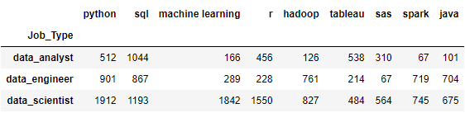
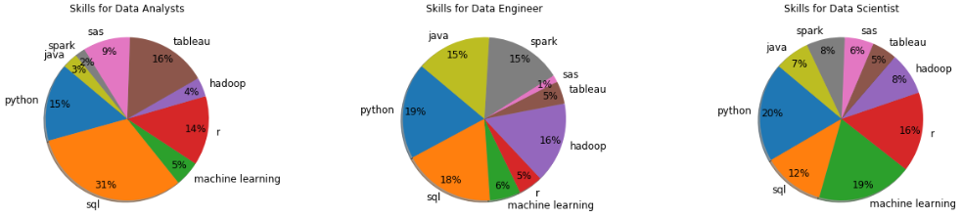
Notes:
Vidhya- We created table (jump to jupyter)
Wrong answer- We thought the same thing as you but It turns out that the number one skill for a data analyst is SQL. As you can clearly see SQL is by far the most desired skill. This is exactly why we decided to dive into this dataset to find concrete evidence of what the top skills actually are. *****Here we created a summary table of the number of jobs requiring these skills in each of the job types listed. By grouping by job type and calling a sum on this grouped object.
This allowed us to create pie charts based on the summary table.

Slide 15
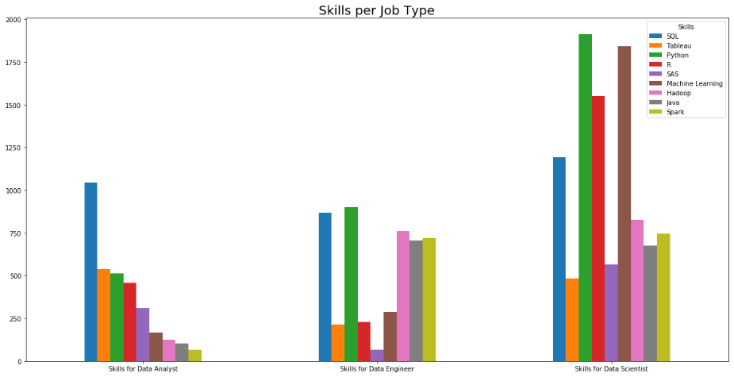
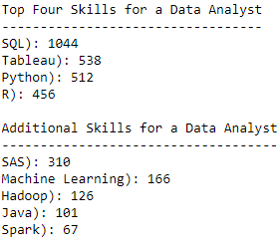
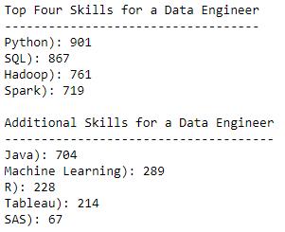
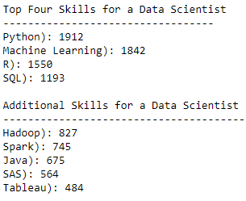
Notes:
George- We decided to also display that information in a bar chart. Typically when you have more than four categories in a pie charts it loses its effectiveness. Here you can more easily digest which skills are more valuable.

Slide 16
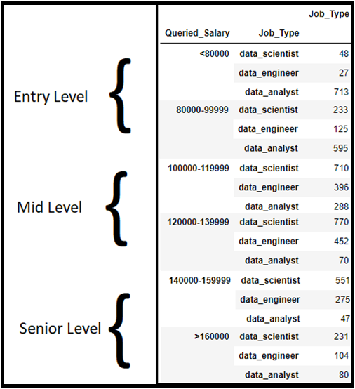
Notes:
George- we categorized the salaries in to job levels
Entry level jobs ranged from up 30,000 up to 100,000
Mid level jobs ranged from 100 to 140
And senior jobs ranged from 140 to 160+
One thing to take note of is most entry level jobs tend to be data analyst positions and converlsy most senior level jobs tend to be data scientist position

Slide 17
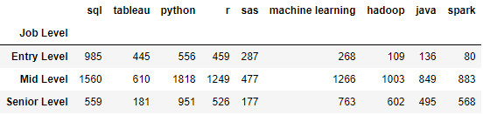
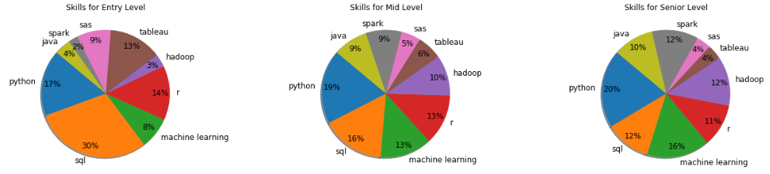
Notes:
Vidyah- similarly to the job types we created a summary table grouped by salary level and call a sum function on it. We then displayed the summary in pie charts

Slide 18
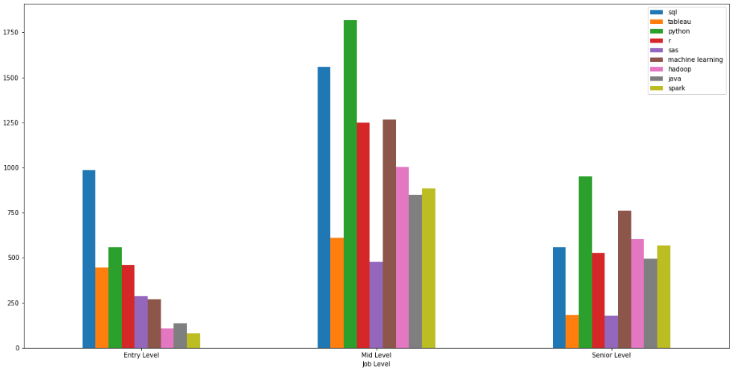
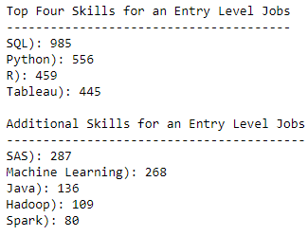
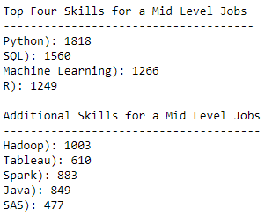
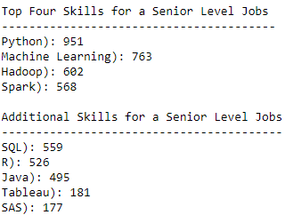
Notes:
George- Here is that same information displayed in a bar chart. Although the count of additional skills does drop off quite significantly. They shouldn’t be ignored because knowing them will you a more well rounded data professional.
Data visualization is a matter of preference. Just out of curiosity by a show of hand how many of you prefer the bar chart and how many of you prefer the pie chart

Slide 19

  What are the top 4 skills a hopeful data professional should focus on mastering in order to be an ideal candidate for an entry, mid, or senior level position in the fields
  of Data Science, Data Engineering, or Data Analysis?

Slide 20
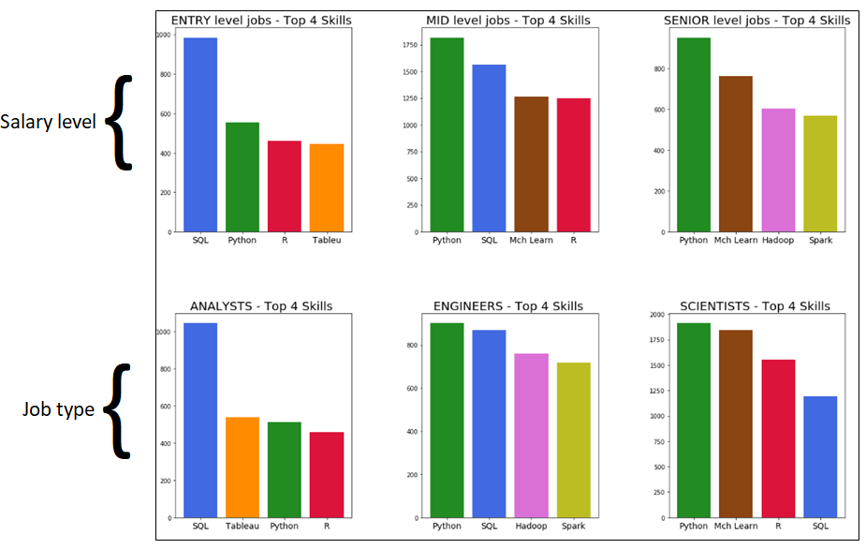
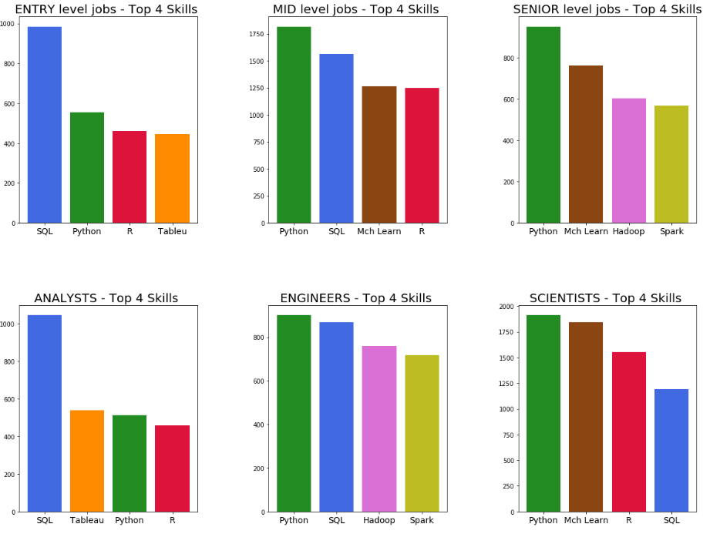
Notes:
Vidyah- Here are the top four skills for salary level as well as job type. If you are someone who is looking to break into a data professional job you should focus mostly on mastering python and sql. One thing you’ll notice is the skills for an entry level job and a data analyst job are the same which reinforces the point that m***. As a data professional transition into a mid level job their competency of python becomes more prevalent as does machine learning. By the time a data professional reaches senior level they should’ve fully mastered python and machine learning as well as have a thorough understanding of Hadoop and spark .
Im sure the ultimate goal for most of us in this bootcamp is to become a data scientist. However, in order to do so you need a masters degree. The best track to obtain a position as a data scientist could be to work as a data analyst for a few years while pursuing a master degree. In an ideal situation your employer will be willing to fund the cost of your higher education. By the time you have completed your masters hopefully you have also been working on improving your skills in machine learning which is a major requirement of data scientist.

Slide 21
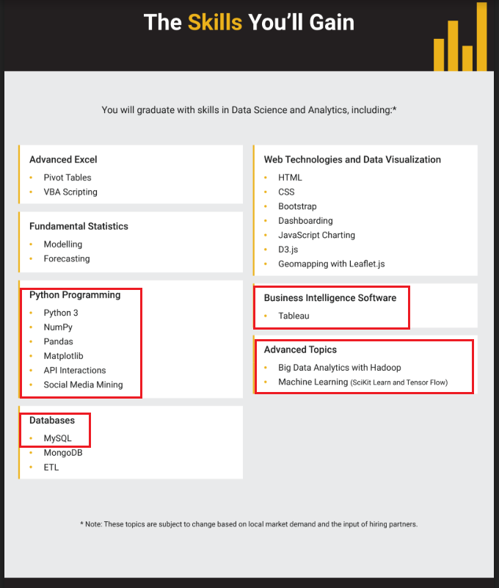

Bootcamp curriculum correlation to job skills
Notes:
Fortunately we have invest out money into the correct bootcamp because our curriculum coincides quite well with the most in demand skills for a data professional. I would like the floor to any questions at this moment.

